Slide 1

12th Workshop
“Software Engineering Education
and Reverse Engineering
Automatic generation
of initial conceptual data models
from UML activity diagrams
Dražen Brđanin, Slavko Marić
Faculty of Electrical Engineering, University of Banja Luka, Bosnia and Herzegovina

Slide 2
Content
Background
  Motivation. Research Participants.
Introduction
  Basic Idea. CDM Automatization Approaches. Related work.
Semantic capacity of UML AD (BPM) for automated generation of UML CD (CDM)
  Analysis. Specification of formal rules.
Target Model weaving
Scalability
Experimental Results
Publication of Research Results
Conclusion

Slide 3
Background
Motivation
Business modeling = first phase of IS development
  BPM is used for the identification of system requirements
  BPM can be used for automated generation of target software models
Business modeling and database design use different notations that usually don't conform to the same/common metamodel
  BM – characterized by process-oriented notations: IDEF0, EPC, BPMN, ...
  DB design – ER (IE, IDEF1X, …) traditionally used + UML CD
Notational disharmony
  problem and challenge in automated CDM design based on BPM
  one of the reasons for a fairly small number of research in the field
Solution: use of UML for both BM and DB design
Research participants
Research conducted by mr Dražen Brdjanin, as part of his work on PhD thesis
Slavko Marić, advisor and co-author of published papers
Several undegraduate and graduate students

Slide 4
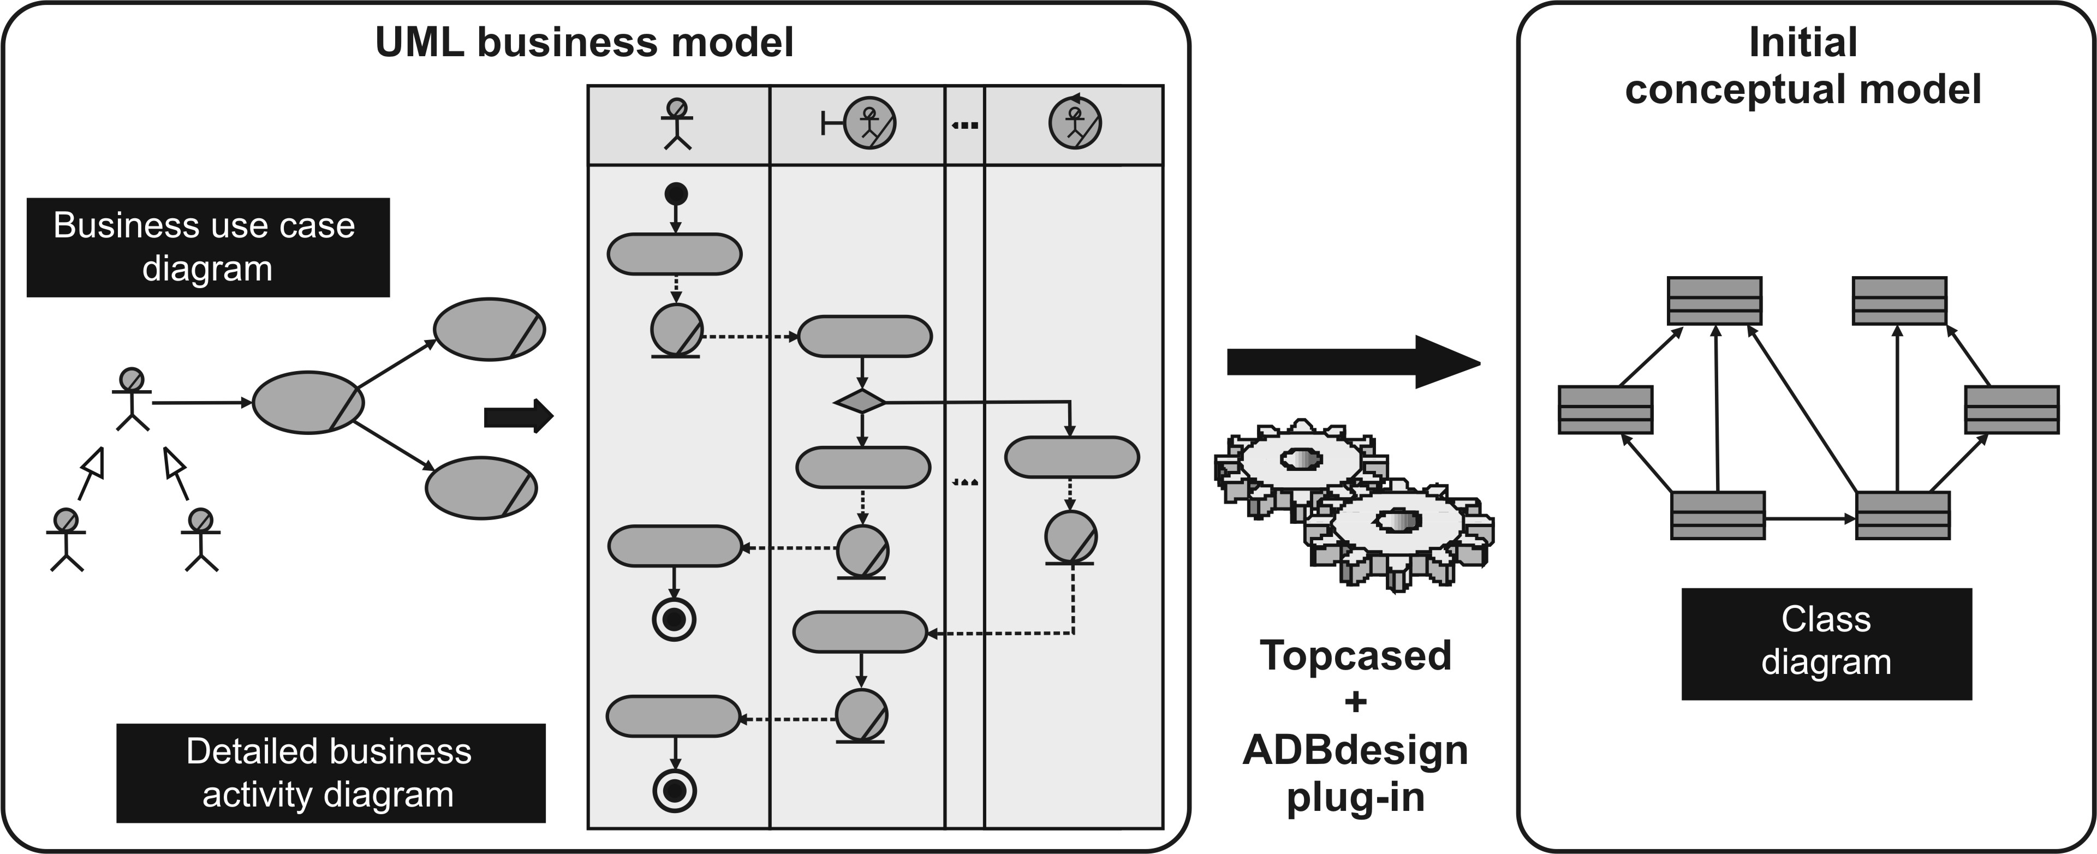
Basic Idea
Automated CDM (UML CD) design based on BPM (UML AD)
?
Semantic capacity of AD for automated CDM design is not fully explored and identified yet!
Several proposals for CDM based on AD, but there are only a few implementation of automated CDM generator with modest achievements in automated CDM generation!

Slide 5
CDM automatization approaches
Automatization of CDM design has been the subject of research for many years!
CDM
Linguistics-based
approaches
?
Model-based
approaches
Forms-based
approaches
Textual specification of information requirements
UML AD
BPMN

Slide 6
Related work (1/2)
Garcia Molina et al. (ER 2000) propose the initial conceptual model based on UML AD and supplementary glossary
?
direct mapping of all information objects into the respective classes in the target CD
creation of class associations based on business rules informally specified in the glossary - NOT suitable basis for automatic generation
NO implementation
Glossary
RULES

Slide 7
Related work (2/2)
BA
W₁
W_{N}
Rodriguez et al. (FP-UML 2008) propose the direct mapping of all information objects and all business process participants into the respective classes in the target CD
BA
W₁
W_{N}
E₁
E₁
E₃
E₃
?
E₂
?
QVT implementation
E₂
E₄
E₄
Suarez et al. (WCE 2008) propose automatic creation of associations for activities that have input and output objects, as direct mapping of those activities to the respective associations between corresponding classes
Limitations related to automated generation of multiplicities, since they don't propose any explicit rule

Slide 8
Overview of our approach
ADBdesign generator
❶
direct mapping of all
business objects
to the respective classes
❷
direct mapping of all
business process
participants
to the respective classes
❸
creation of associations
between business objects and
business process participants
based on actions performed on
those objects
Role
❹
creation of associations
between business objects
Action
Action
Input
Action
Input
Action
Output
Output

Slide 9
Semantic capacity of BPM (1/8)
Semantic capacity of BPM for automated CDM design is not identified yet!
Typical business process patterns
Object creation
existing
objects
Subsequent usage of created object
Activation of existing object
generated
object
Subsequent usage of activated existing object

Slide 10
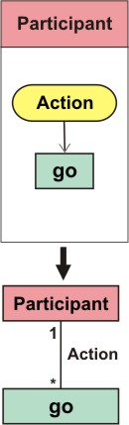
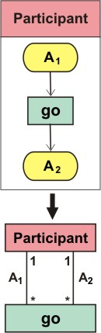
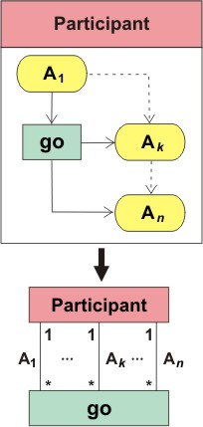
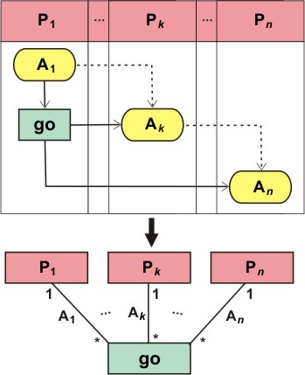
Semantic capacity of BPM (2/8)
Creation of objects
Subsequent usage of generated objects

Slide 11
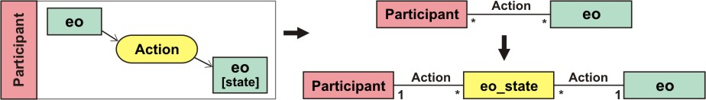
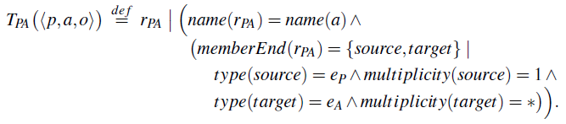
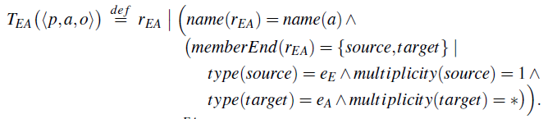
Semantic capacity of BPM (3/8)
Activation of existing objects

Slide 12
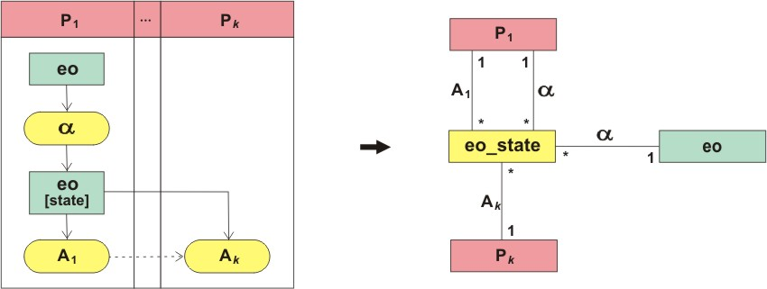
Semantic capacity of BPM (4/8)
Subsequent usage of activated existing objects
eo_state = go

Slide 13
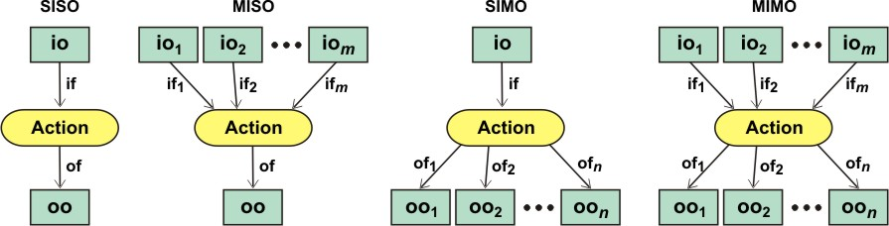
Semantic capacity of BPM (5/8)
OBJECT-OBJECT associations
Suarez et al. (WCE 2008)
Proposal for automatic creation of associations for actions that have input and output objects, as direct mapping of those actions to the respective associations between corresponding classes, but without any explicit rule for automated generation of association end multiplicities
Our proposal
Direct mapping of such action into the set of binary associations
Classification of actions regarding the number of different type of IOs and OOs

Slide 14
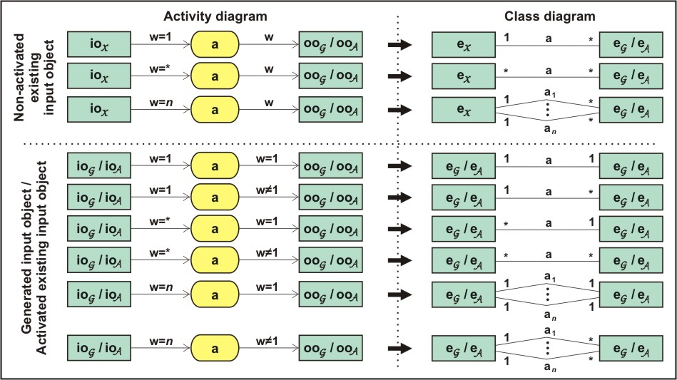
Semantic capacity of BPM (6/8)
SISO (Single Input / Single Output) actions

Slide 15
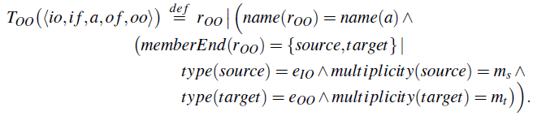


Semantic capacity of BPM (7/8)
Formal rule for mapping SISO tuple into the set of binary associations
m_{s}
a₁
m_{t}
if
of
io
oo
io
a
oo
{ weight=w_{if} }
{ weight=w_{of} }
m_{s}
a_{n}
m_{t}
Notes:
15

Slide 16
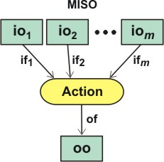
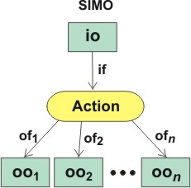
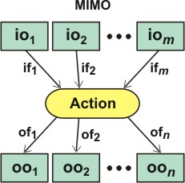
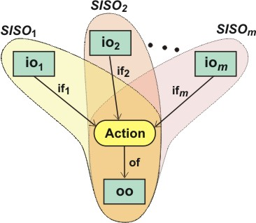
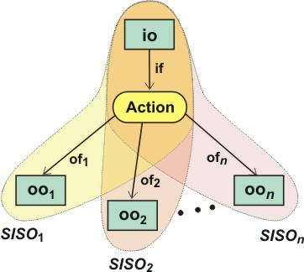
Semantic capacity of BPM (8/8)
MISO actions
SIMO actions
MIMO actions
Each MIMO action can be considered as a set of concurrent SISO actions
i.e. basic SISO rule is to be
applied to each SISO tuple.
Notes:
16

Slide 17
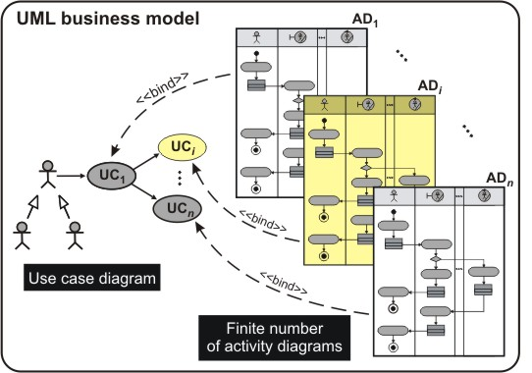
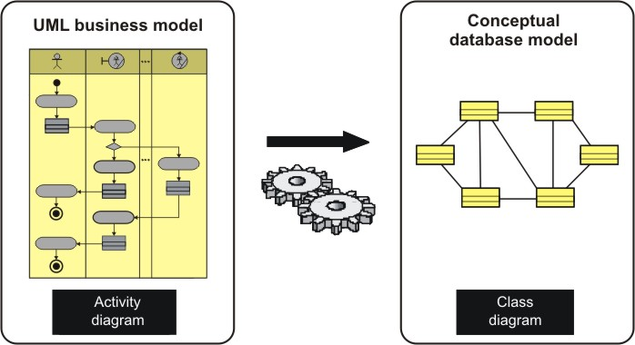
Scalability
All previous proposals consider only one single business process diagram!
Topcased
+
ADBdesign
plug-in
This issue is the subject of the paper that will be presented at ADBIS 2012 Conference (Poznan, Polland)

Slide 18
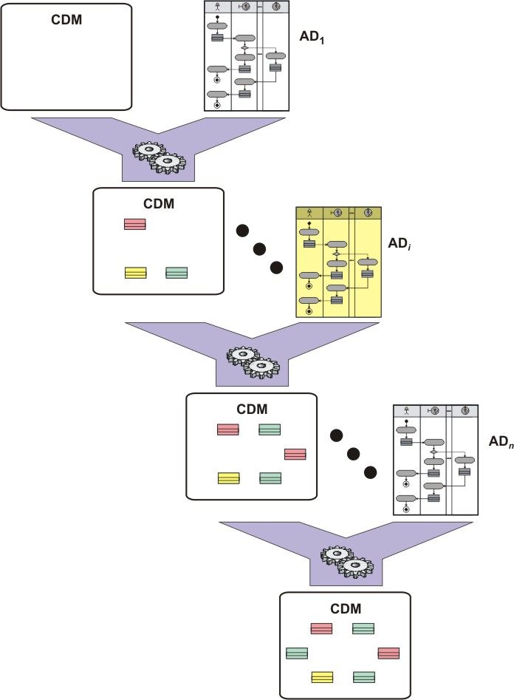
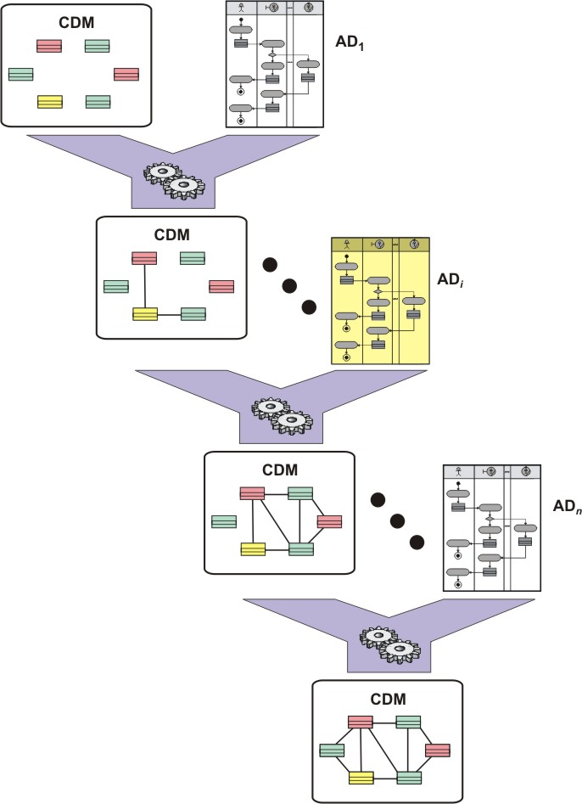
Model weaving
The implemented two-phase automatic generator (ADBdesign) iterates through the source BM, processes all ADs and generates the target CDM
2nd phase
Generation of
associations
participant –
generated object
participant - activated object
existing object –
activation
1st phase
Generation of classes
object - object
participants
objects
activations
Notes:
18

Slide 19
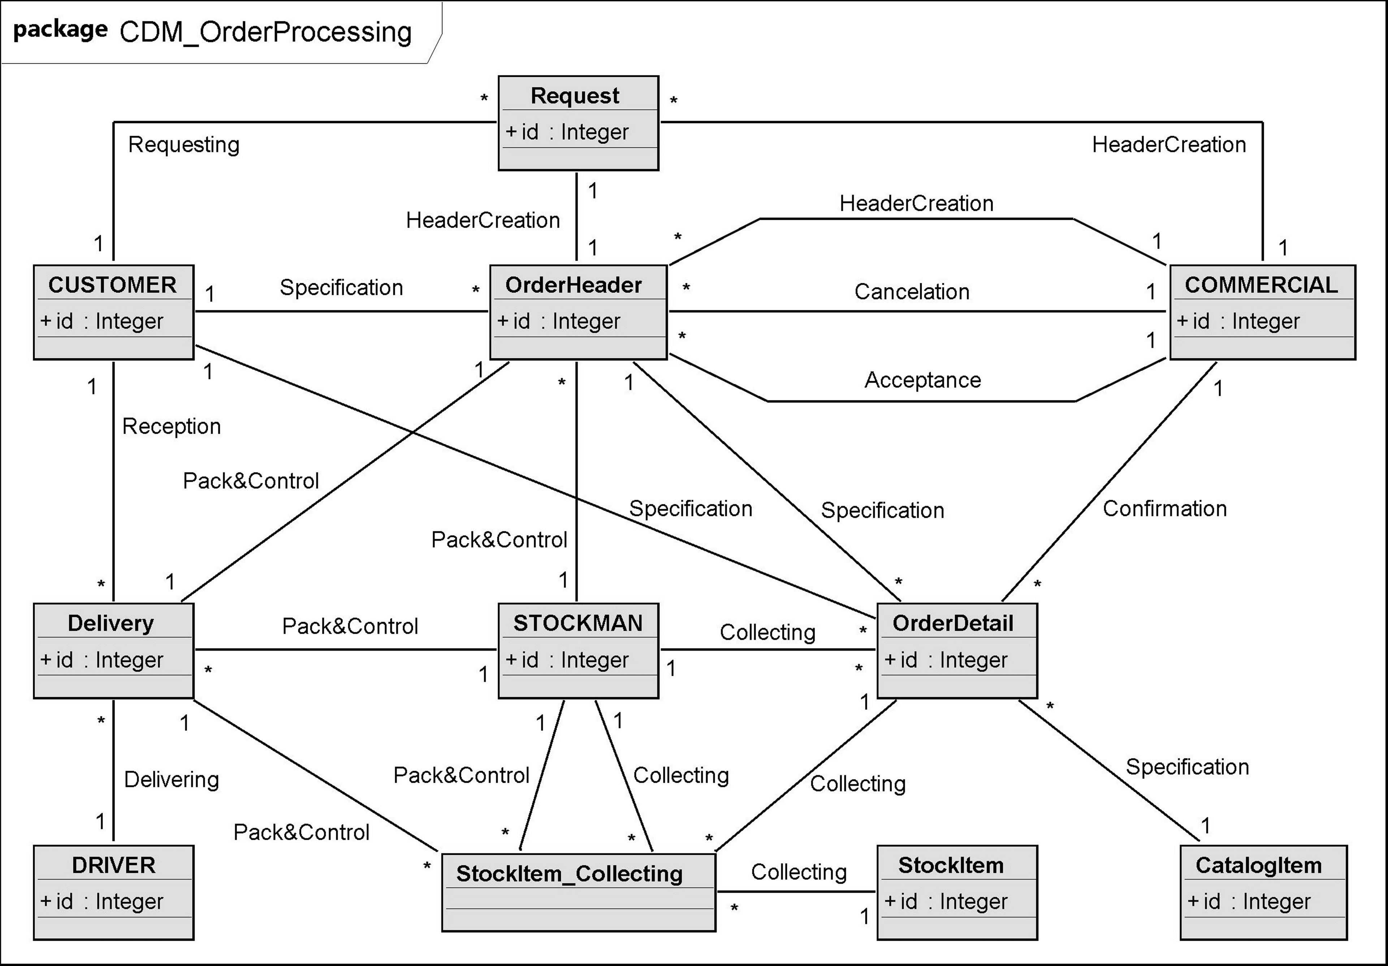
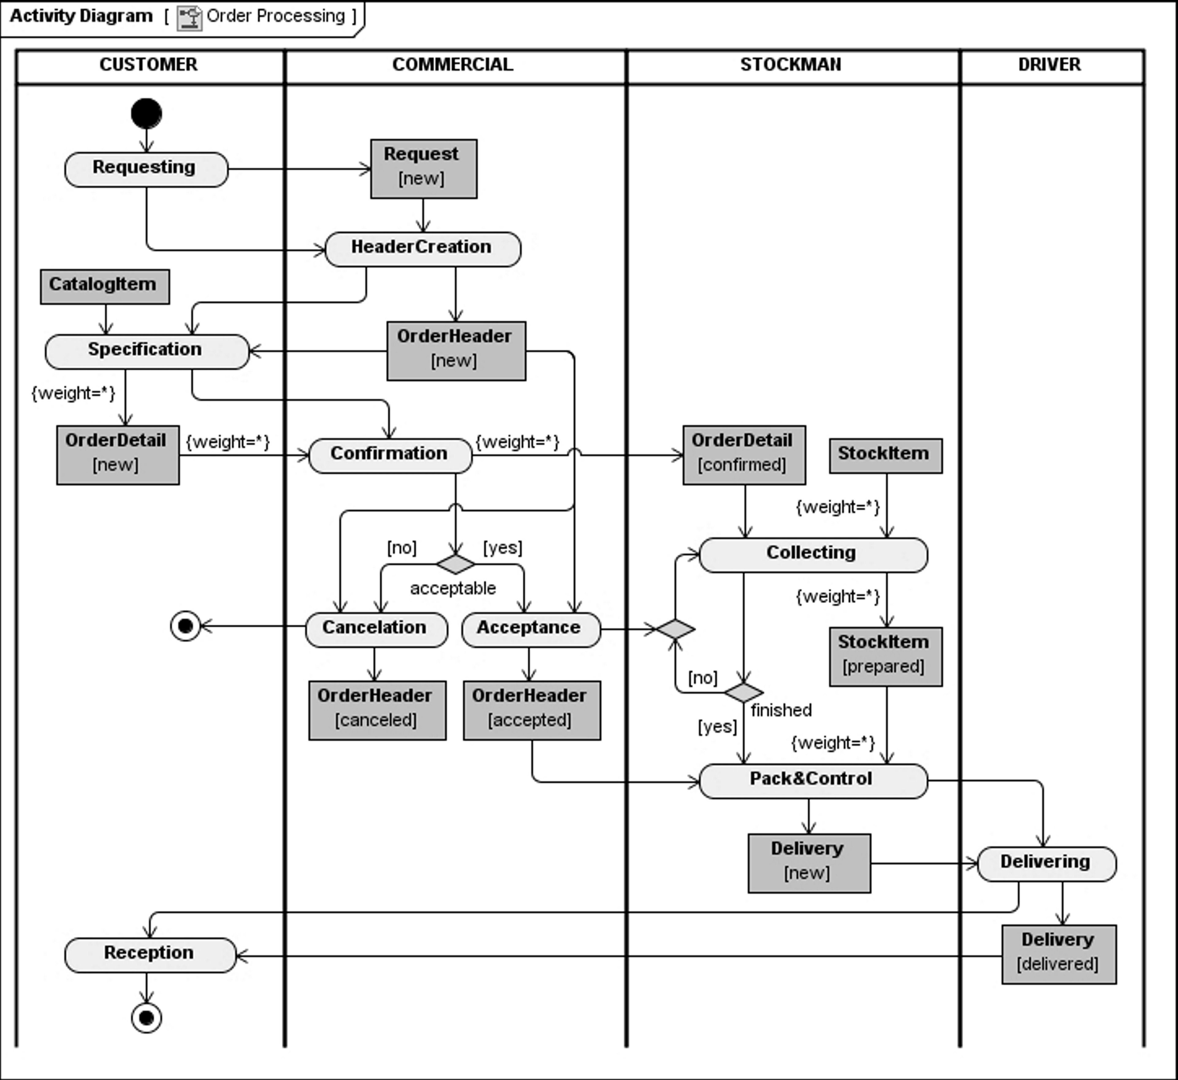
Experimental results
Notes:
19

Slide 20
Publication of research results
Research results published on a number of internationaly recognised journals and conferences:
  D. Brdjanin, S. Marić, “Towards the Automated Business Model-driven Conceptual Database Design”, ADBIS 2012
  D. Brdjanin, S. Marić, “An Approach to Automated Conceptual Database Design Based on the UML Activity Diagram“, ComSIS Journal, Vol. 9, No. 1, January 2012, pp. 251−285
  D. Brdjanin, S. Maric, “On Automated Generation of Associations in Conceptual Database Model”, ER 2011 workshop, Brussels, Belgium, in Advances in Conceptual Modeling, Recent Development and New Directions, LNCS, Vol. 6999, pp 292–301, 2011
  D. Brdjanin, S. Marić, “Towards the initial conceptual database model through the UML metamodel transformations”, Proc. of the EUROCON 2011 – Interna -Itional Conference on "Computer as a tool", Lisbon, Portugal, pp. 1–4, 2011
  D. Brdjanin, S. Marić, D . Gunjic, “ADBdesign: An approach to automated initial conceptual database design based on business activity diagrams“, ADBIS 2010, LNCS, Vol. 6295, pp. 117−131, 2010
  ...

Slide 21
Conclusion
An approach to automated generation of initial CDM (UML CD) based on BPM (UML AD) has been presented.
Based on UML metamodel specifications for DAD and CD, and on analysis of semantic capacity of UML DAD, formal rules were defined for automatic generation of initial CDM (UML CD).
Two phase automatic generator of initial CDM has been implemented with:
  Generation of classes corresponding to participants, objects and activations (1st phase)
  Generation of participant – object and object – object associations (2nd phase), with the corresponding multiplicity.
The results of the qualitative and quantitative analysis of the generator’s application to the sample model, as well as the preliminary results of application to some other BPMs in different business domains, show that the generator is able to generate a very high percentage of the target CDM (recall usually exceeds 90%) and has a very high precision (over 90% of all automatically generated concepts are usually correct).
21

Slide 22
12th Workshop
“Software Engineering Education and Reverse Engineering"
Dražen Brđanin, Slavko Marić
University of Banja Luka, Bosnia and Herzegovina
Automatic generation of initial conceptual
data models from UML activity diagrams
Thank You!

